Slide 1
Education Funding Commission
A short update on Progress to Date
October 30, 2020

Slide 2
Series of Interrelated Questions
What is the scope of current inequities in educational opportunities?
What constitutes an adequate education in 2020? [to meet NH Constitutional requirement]
What does a basic adequate education cost per pupil?
How do the costs of adequacy vary by type of student need, and how should those factors be represented in NH’s funding formula? [differentiated aid]
How does community property wealth [equalized valuation] affect educational opportunity?
What are the gaps between current education funding and costs of adequacy?
What are the sources of revenue to meet the gaps, i.e. pay for adequacy and address inequities? [state-mandated locally collected property tax + local property tax + other approaches that will fit within the Supreme Court mandates]
How should a formula take into account differences in capacity to raise revenue? [community capacity and individual ability to pay]
How should that revenue be collected and distributed?

Slide 3
Background Understandings
NH already has high level of funding per pupil as statewide average
NH students perform at relatively high levels on outcomes
Disparities in opportunities and outcomes persist
Disparities are correlated with capacity of local communities to raise property tax dollars to meet student needs
Weaknesses/issues in many places that make solutions difficult…..insufficient authority to gather data to assess commercial properties accurately….limited authority of Dept of Ed….no efforts at consolidation driving costs through the roof….and so forth

Slide 4
Commission Primary Methods
AIR Study
Perspectives
Use NH DOE school data about student characteristics and performance, attendance, graduation to predict what it would cost for each school/district to achieve statewide average outcomes
Testimony/reports from state/regional experts
Focus group sessions
Public comment at each session, special sessions, written comment
Granite State poll (1000+)

Slide 5
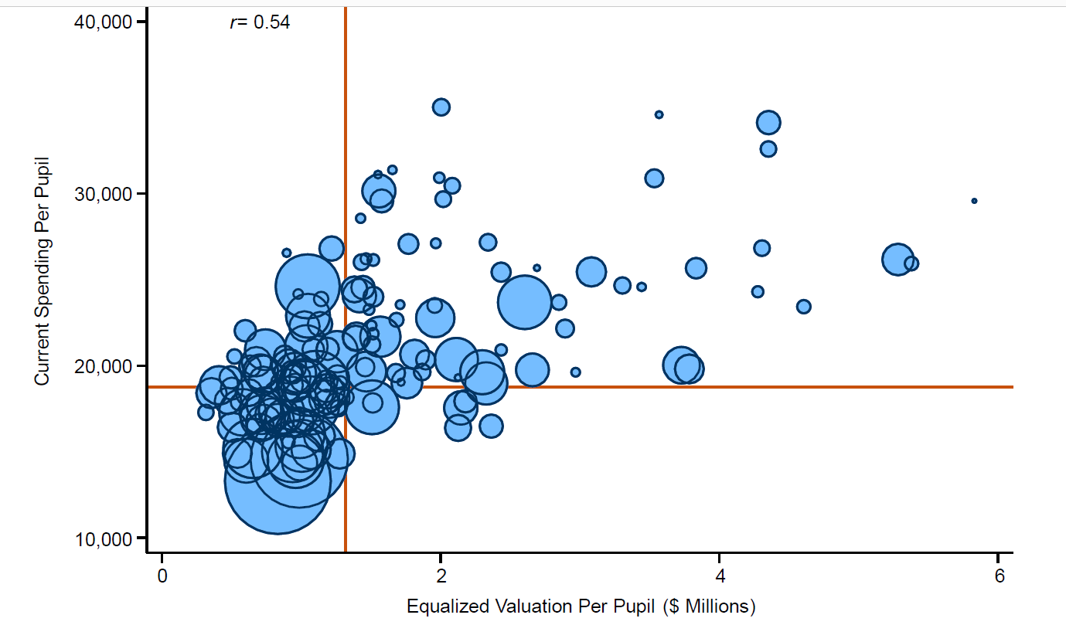
Districts with higher property values generally spend more than districts with lower property values

Slide 6
Districts with the lowest poverty rates typically have outcomes that are 1–2 standard deviations above the state average

Slide 7
Adequacy defined in terms of outcomes
Original Formula was Input Based
Add up list of associated costs and determine base
Assign extra weights for students who have special needs, are low income, are English learners—differentiated aid
2020 Approach is Outcome Based
Construct composite outcome score (graduation rate, performance on state assessments, attendance)
Determine desired level of performance for all…set at 50% ile
Statistically determine what extra costs are required by students with different needs
Predict cost required for each district to achieve adequacy

Slide 8
Granite State Poll
Generally people don’t understand how we fund education
Most underestimate what districts spend--$9500 (actual $19,000)
55% agree that funding for schools should be increased; 28% stay the same
44% think percent of education costs funded by local property taxes should decrease; 32% stay same
How to decrease reliance on local property taxes for education?
47% oppose statewide property tax
69% oppose sales tax
69% oppose income tax

Slide 9
Current Discussions
How should taxpayers’ ability to pay be considered?
What would constitute a meaningful property tax “circuit breaker” for low and moderate income home owners? ….paid for by state dollars?
How could a state-run tax deferral approach work for older residential taxpayers?
Should the statewide property tax be applied at a uniform rate?
How could accountability be increased for districts receiving substantial state funding? [assurances that $ are spent on education, requirement for using evidence-based approaches]
Beyond a basic funding formula, what categorical funding is necessary (e.g., school building aid, catastrophic aid, pre-K, etc.)?

