Slide 1
Education Funding Commission
A short update on Progress to Date

Slide 2
Series of Interrelated Questions
What is the scope of current inequities in educational opportunities?
What constitutes an adequate education in 2020? [to meet NH Constitutional requirement]
What does a basic adequate education cost per pupil?
How do the costs of adequacy vary by type of student need, and how should those factors be represented in NH’s funding formula? [differentiated aid]
How does community property wealth [equalized valuation] affect educational opportunity?
What are the gaps between current education funding and costs of adequacy?
What are the sources of revenue to meet the gaps, i.e. pay for adequacy and address inequities? [state-mandated locally collected property tax + local property tax + other approaches that will fit within the Supreme Court mandates]
How should a formula take into account differences in capacity to raise revenue? [community capacity and individual ability to pay]
How should that revenue be collected and distributed?

Slide 3
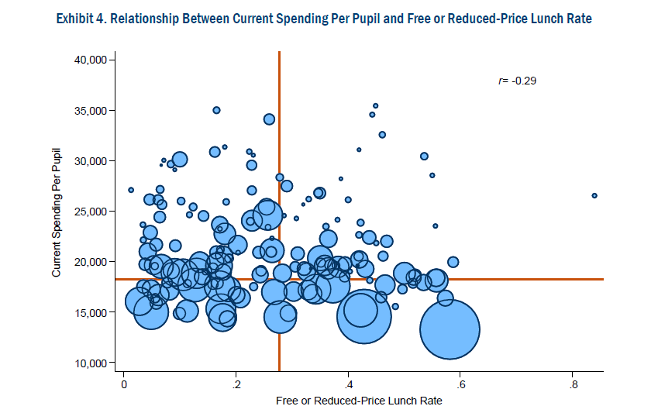
NH districts with higher poverty rates spend less, on average,
than with districts with lower poverty

Slide 4
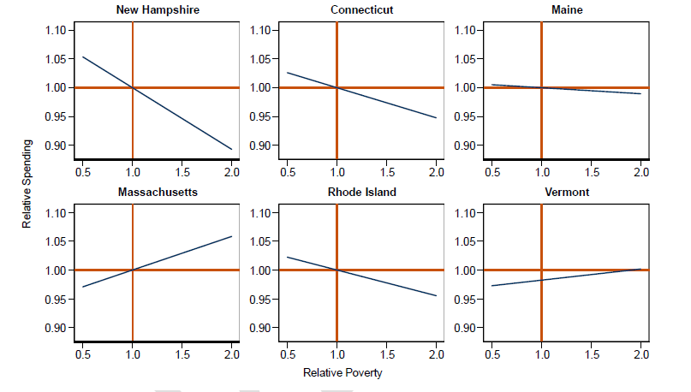
In NH districts with higher needs have fewer education resources

Slide 5
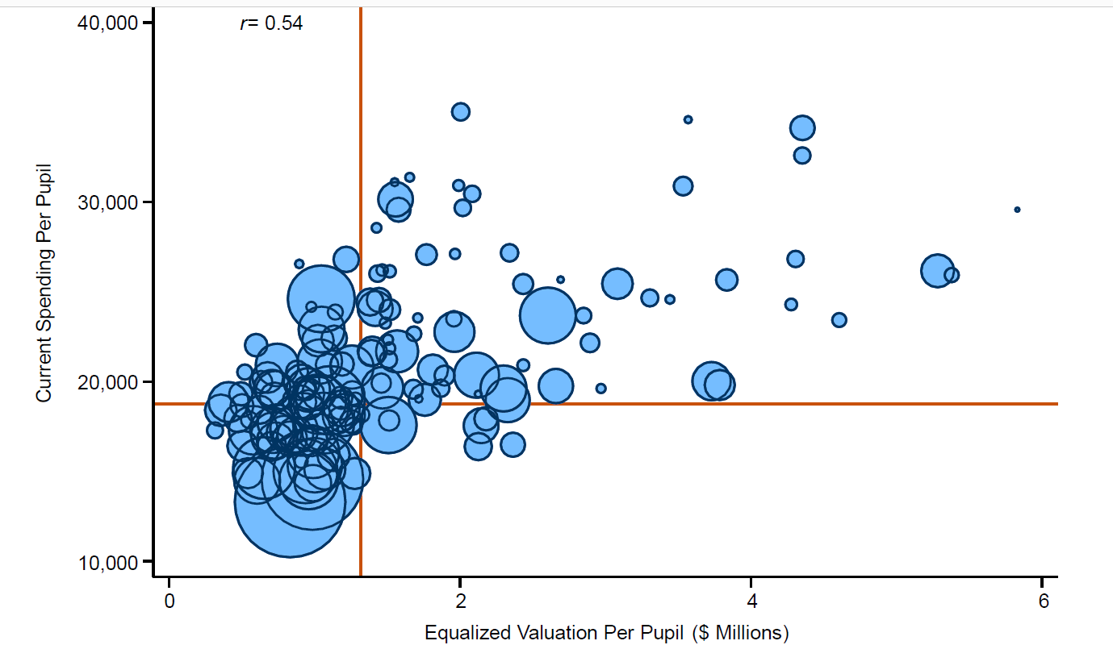
Districts with higher property values generally spend more than districts with lower property values

Slide 6
Adequacy defined in terms of outcomes
Original Formula was
Input Based
Add up list of associated costs and determine base
Assign extra weights for students who have special needs, are low income, are English learners—differentiated aid
2020 Approach is Outcome Based
Construct composite outcome score (graduation rate, performance on state assessments, attendance)
Determine desired level of performance for all…set at 50% ile
Statistically determine what extra costs are required by students with different needs
Predict cost required for each district to achieve adequacy

Slide 7
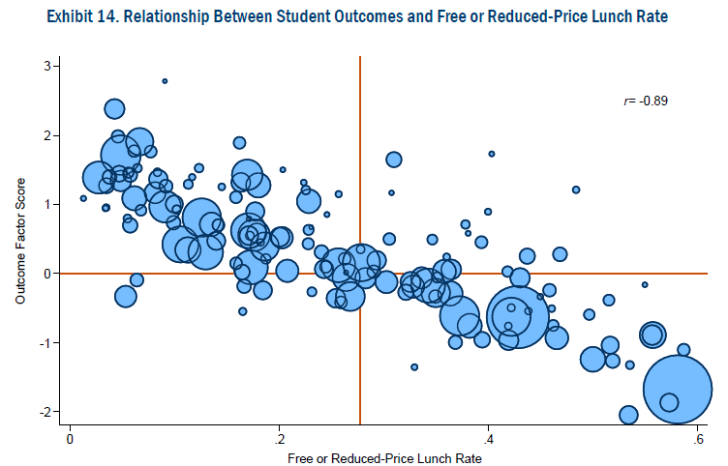
Districts with the lowest poverty rates typically have outcomes that are 1–2 standard deviations above the state average

Slide 8
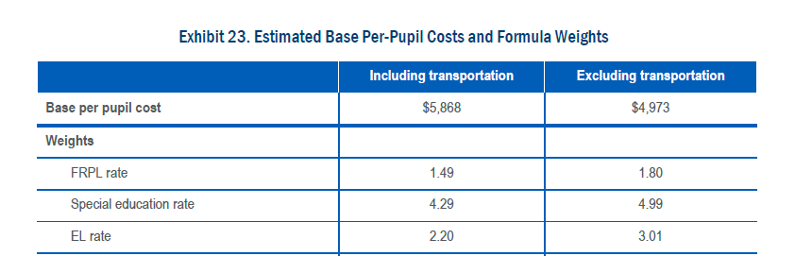
Low income
English learners
Base per pupil cost FY 18-19
FRPL student costs 1.49 times more than base
Special ed student costs 4.29 times more than base (not catastrophic aid)

Slide 9
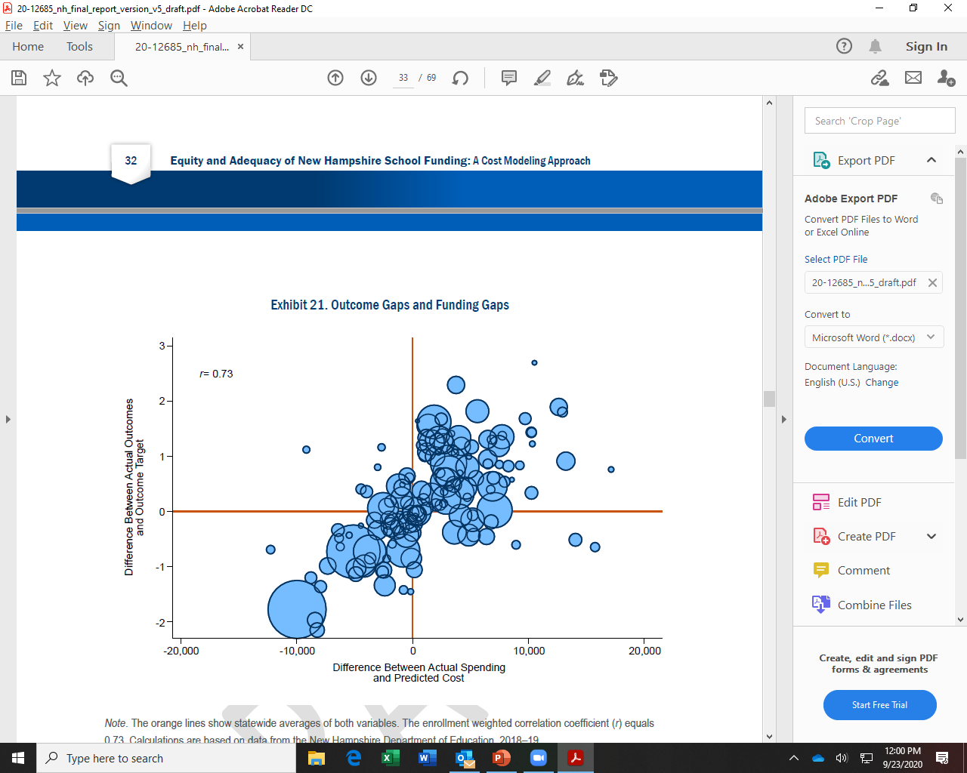
Some districts are severely underfunded (gap between actual and predicted cost ) and they tend to perform well below state average

Slide 10
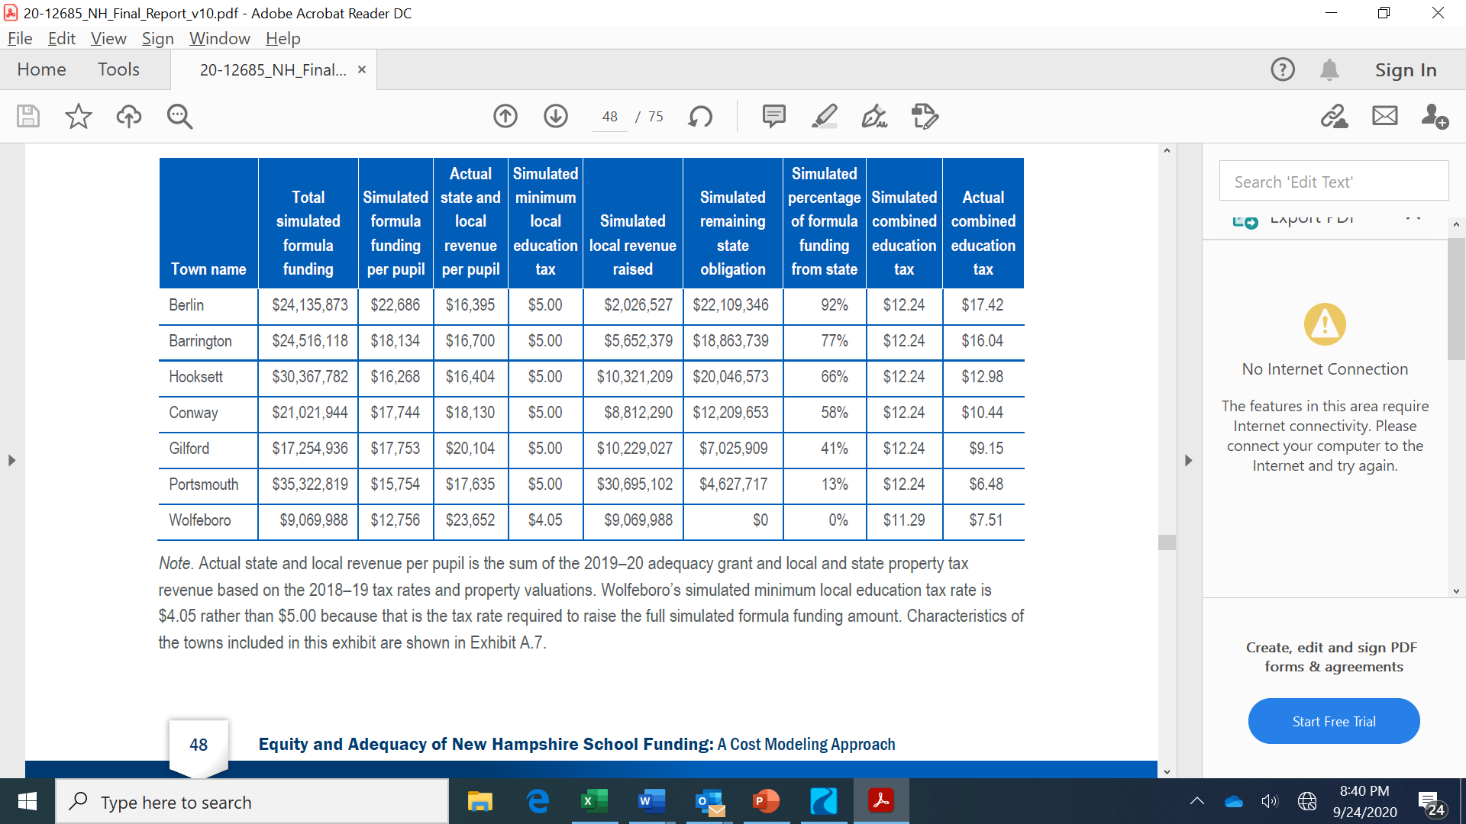
Example: Simulation bringing all districts to 50th %ile performance
With estimated weights and outcomes at 50th percentile, per pupil:
$15,754 (simulation)
$17,635 (actual)
If ONLY property taxes as revenue source, requires another $5.76/$1000 + the cost to address the gap between simulated and actual

Slide 11
Series of Interrelated Questions
What are the sources of revenue to meet the gaps, i.e. pay for adequacy and address inequities? [state-mandated locally collected property tax + local property tax + other approaches that will fit within the Supreme Court mandates]
How should a formula take into account differences in capacity to raise revenue? [community capacity and individual ability to pay]
How should that revenue be collected and distributed?
EMERGING QUESTIONS
How should taxpayers’ ability to pay be considered?
What would constitute a meaningful property tax “circuit breaker” for low income home owners?
Should different types of property be taxed at different rates?
What legal changes are necessary to ensure more accurate valuation of commercial property?
How could accountability be increased for districts receiving substantial state funding? [assurances that $ are spent on education, requirement for using evidence-based approaches]
What efficiencies could reduce overall education costs in NH? [e.g., regionalization of administration)

