Slide 1
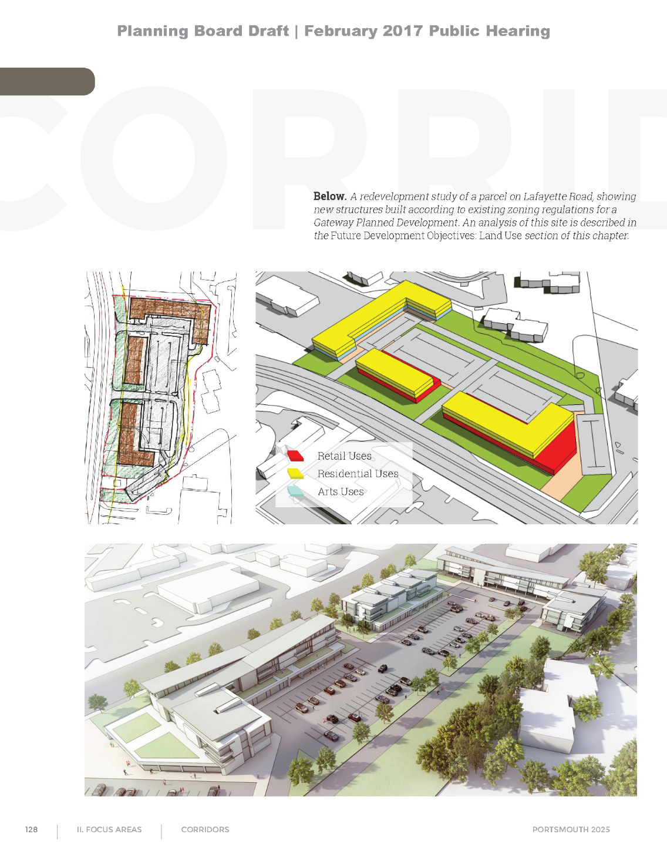
Gateway Mixed Use Districts
Land Use Committee
May 5, 2023

Slide 2
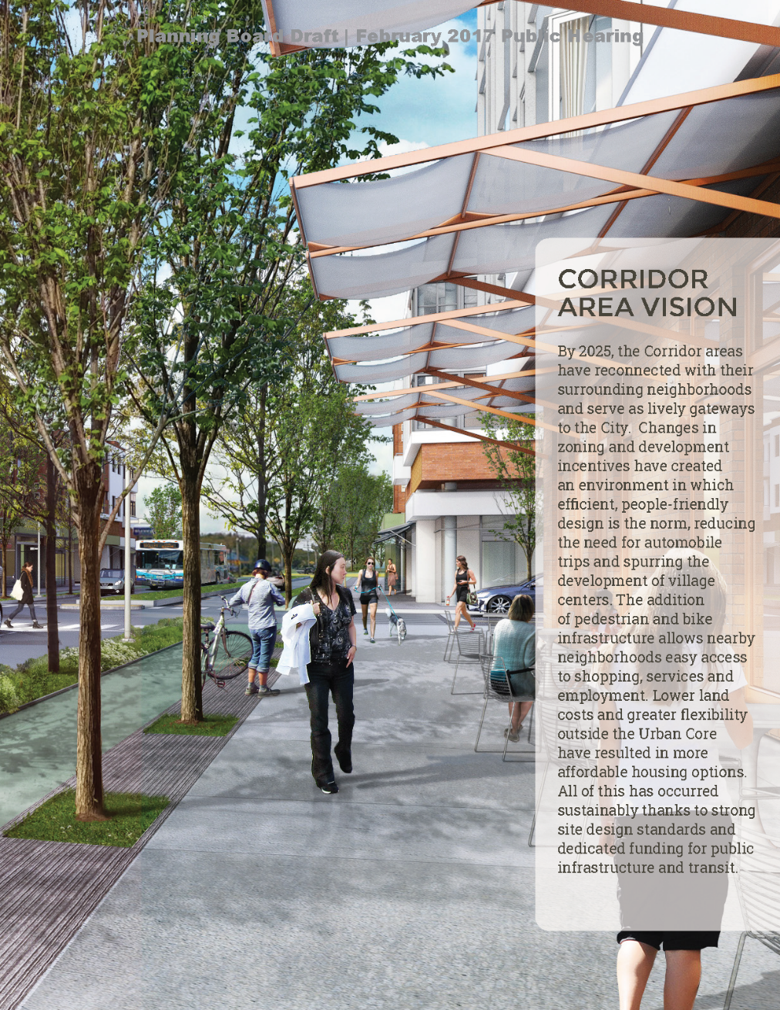
PORTSMOUTH MASTER PLAN
PUBLIC COMMENTS
“Make other areas as special as Downtown. Support unique neighborhoods.”
“Continue to implement plans related to a more walkable, bikeable city, such …across the city.”
“Different areas with stores and venues that are connected and parkable.”
Notes:
Master Plan’s vision was the result of a public process that identified desired components for different areas of the city.

Slide 3
PORTSMOUTH MASTER PLAN
CORRIDOR AREAS
VISION
Connections to surrounding neighborhoods
Lively gateways to the City
Efficient, people-friendly design
Reduced need for automobile trips
Village centers
Pedestrian and bike infrastructure
Easy access to shopping, services and employment
More affordable housing options
Sustainable site design standards
Public infrastructure and transit
Notes:
Public input are summarized here in bullet form for what people wanted to see in the Corridor Areas.

Slide 4
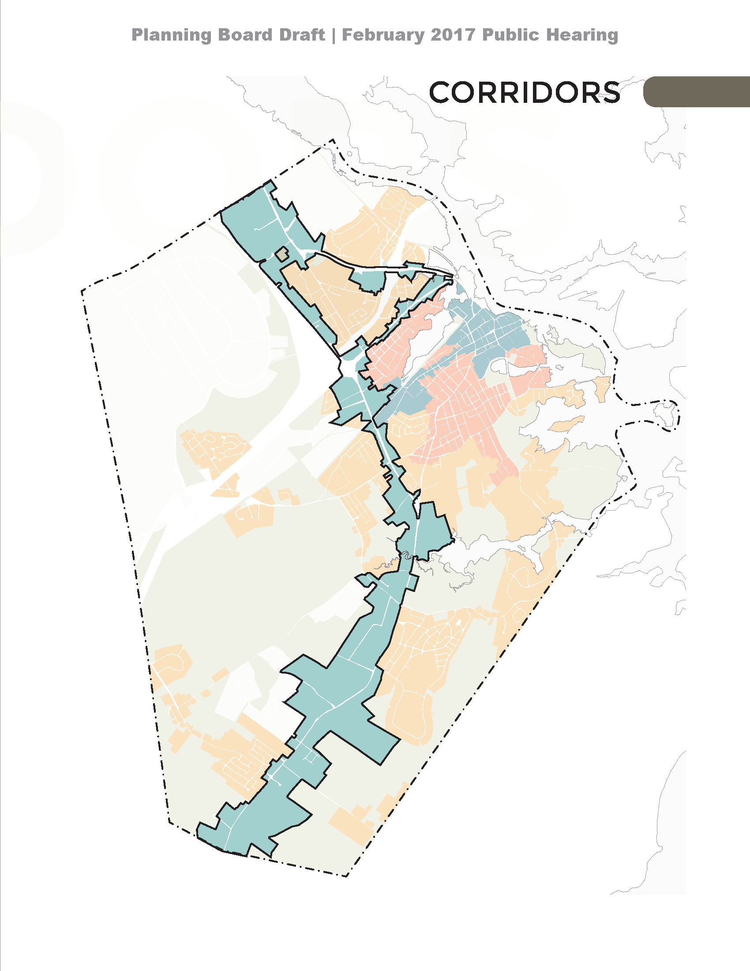
DISTRICT INITIATIVES
General Goals
Walkable Mixed Use Development
Expand and Diversify Housing Stock
Meet Market Demand Including Workforce Housing, Multi-Family and Smaller Dwelling Units
Gateway Zoning Districts / Corridors
Lafayette Road (Route 1)
Route 1 Bypass
Outer Woodbury Avenue
Gateway Zoning Districts / Centers
Mirona Road Area - Lafayette Road (Route 1) and Peverly Hill Road
Exit 7 Area - North side of Market Street on CCC Church Site and Kearsarge Way.
Notes:
Distinguishes between gateway corridors and centers

Slide 5
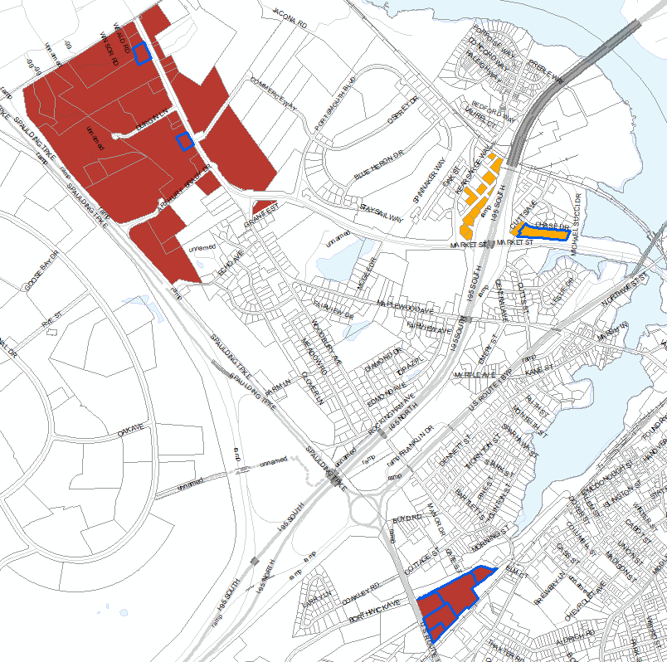
gateway Districts
Gateway Center (G2)
Highlighted Parcels represent recent projects in the Gateway District
Gateway Corridor (G1)
Notes:
In 2017 Gateway zoning amendments were adopted with 2 zoning districts created, G1 and G2. Blue highlighted parcels are properties that have recent projects.

Slide 6
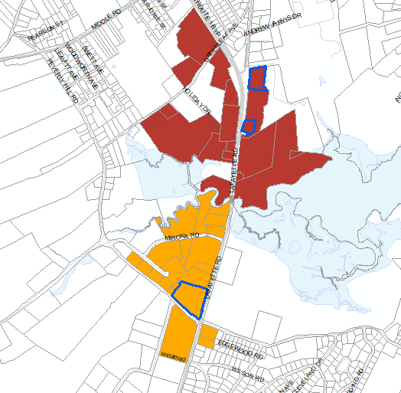
gateway Districts
Gateway Corridor (G1)
Gateway Center (G2)
Highlighted Parcels represent recent projects in the Gateway District
Notes:
1400 Lafayette, Lens Crafter and Tuscan Market

Slide 7
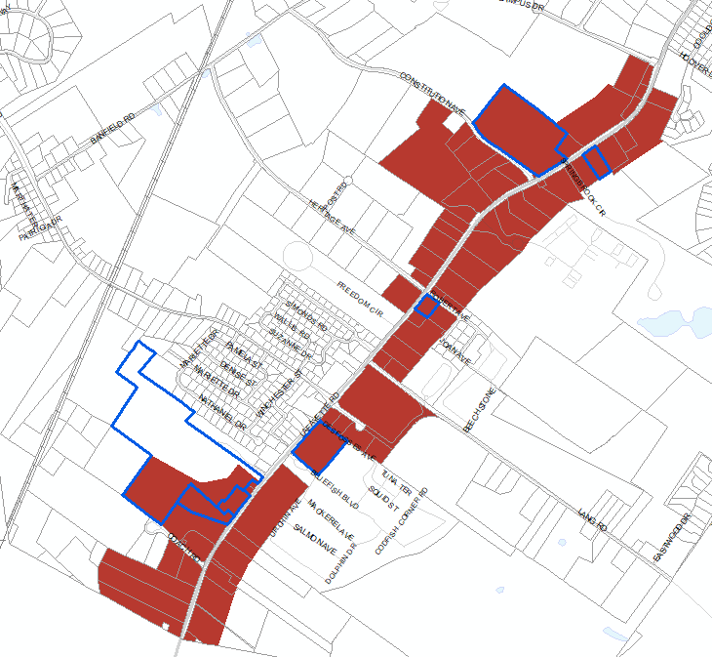
gateway Districts
Gateway Corridor (G1)
Highlighted Parcels represent recent projects in the Gateway District
Notes:
Southern section of G1. Recent projects include Cinemagic, Wren’s Nest, Juniper Lane Condo

Slide 8
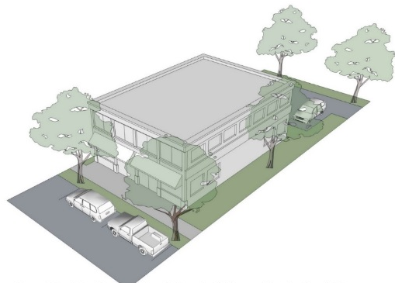
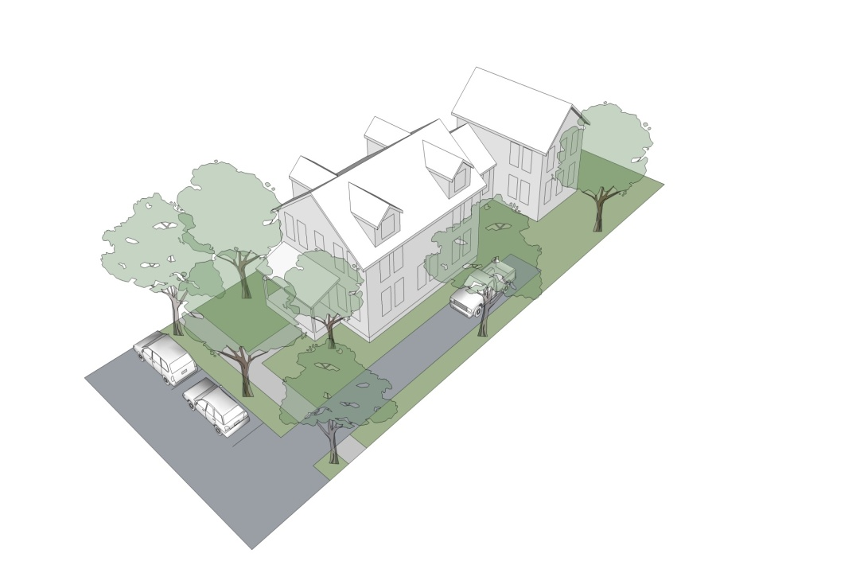
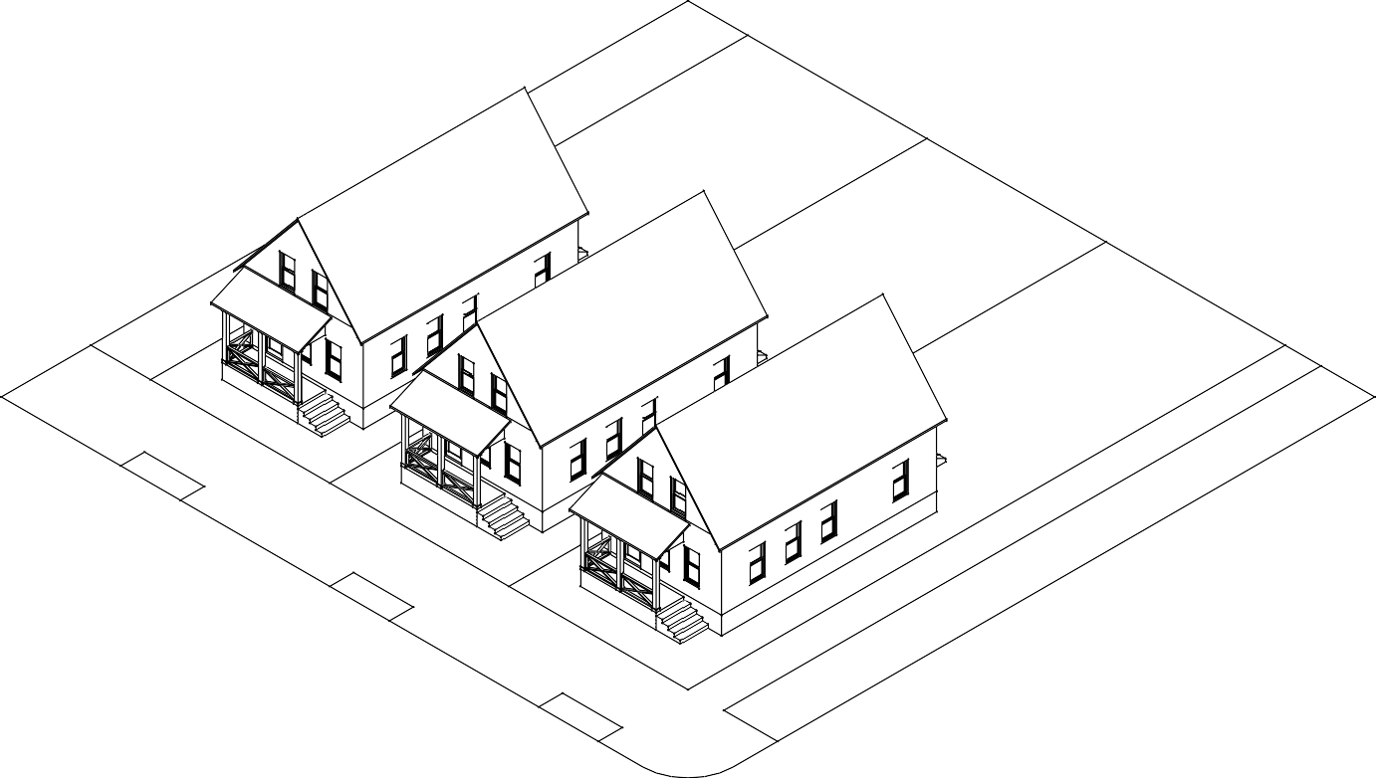
Building Types
Cottage*
Paired House*
Gateway Townhouse*
Apartment Building
Live-Work/Shop Building
Small Commercial Building
Large Commercial Building
Mixed-Use Building*
Flex Space/Fabrication Building*
Community Building*
* indicate Building Types added as a result of the Gateway zoning amendments in 2017.
Notes:
Consistent with what was done in the Character Districts (5A), we identify building types that are allowed in each of these districts. The ones indicated with an * are ones that were added as a result of the Gateway zoning amendments.

Slide 9
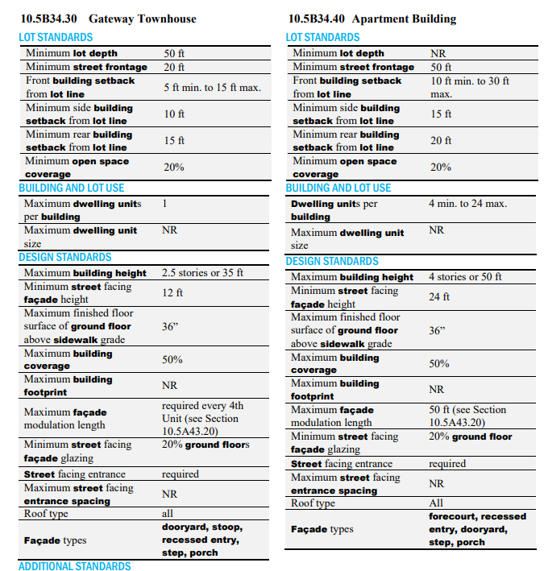
Building Types
Notes:
The dimensional requirements for these building types are then specified in Article 5B. Lot Area, Lot Depth, Street Frontage, Building Setbacks from lot lines, Open Space Coverage, Building Height, Building Coverage, Building Footprint, Façade treatments, etc. These are different from the dimensional requirements for the Character Districts, same building types will have different dimensional requirements in each district.

Slide 10
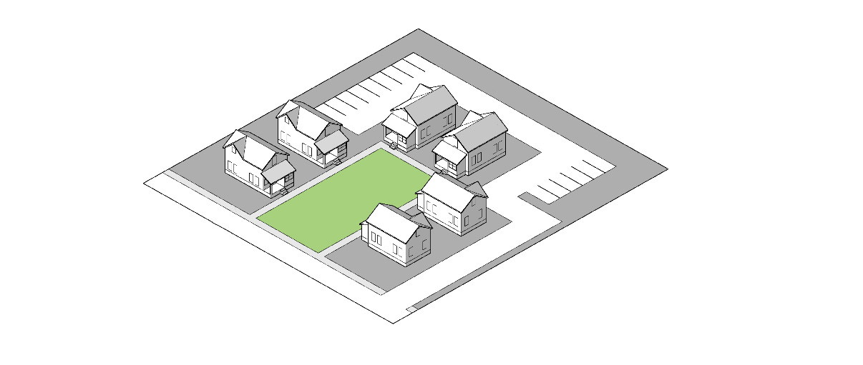
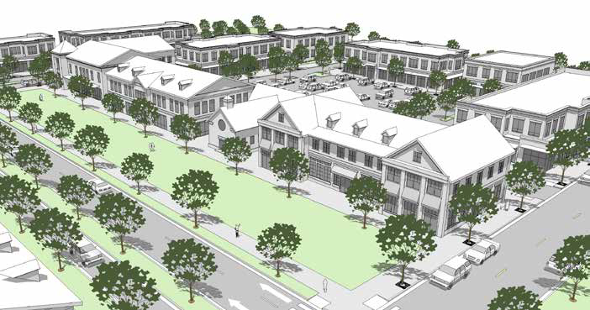
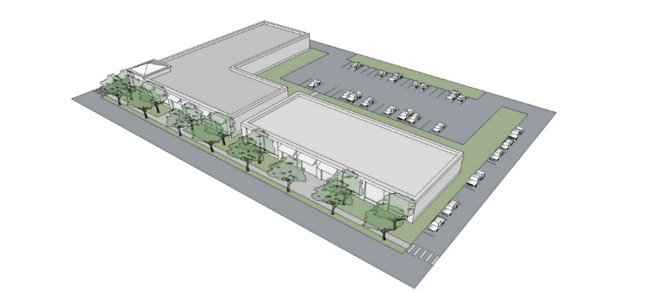
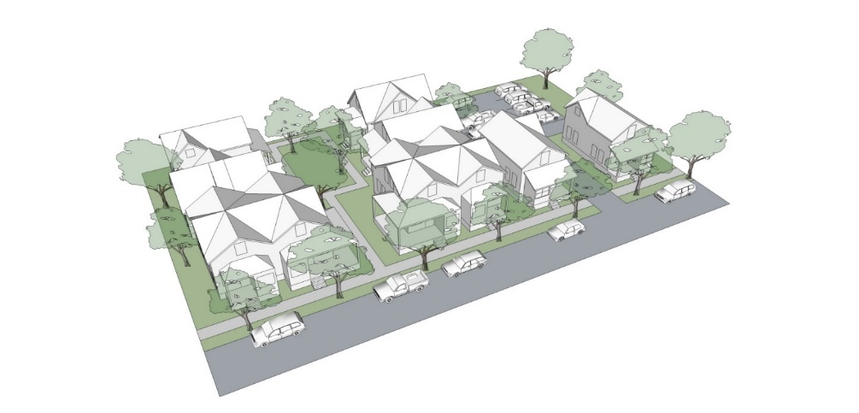
Development Sites
Conditional Use Permit approval from the Planning Board
Any lot or group of contiguous lots owned or controlled by the same person or entity, assembled for the purpose of a single development and including more than one principal building or Building Type.
Pocket Neighborhood Development
Mixed-Use Development
Commercial Development
Residential Development
Notes:
Projects that include multiple bldgs. and/or multiple lots, are called Development Sites. This supports the concept of neighborhood or village center development. All Development Sites required a CUP from the Planning Board – done in collaboration with the Site Review Process.

Slide 11
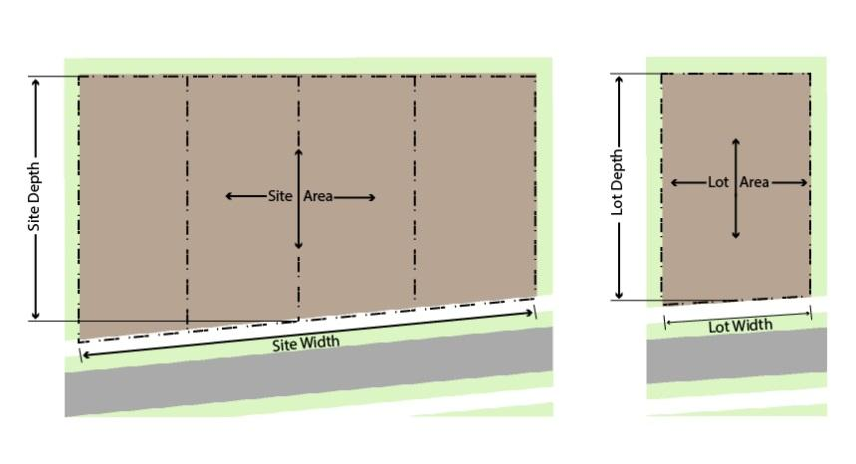
Development Sites
Pocket Neighborhood Development
Mixed Use Development
General Residential Development
General Commercial Development
Notes:
Development Site types are listed here. Each of these include a mix of allowed building types. The standards for Dev Sites also address perimeter areas, and interior access. The building type standards still apply to the buildings within the Site.

Slide 12
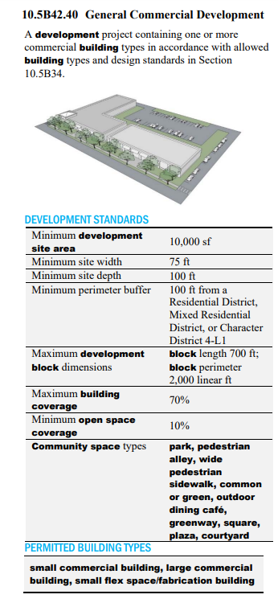
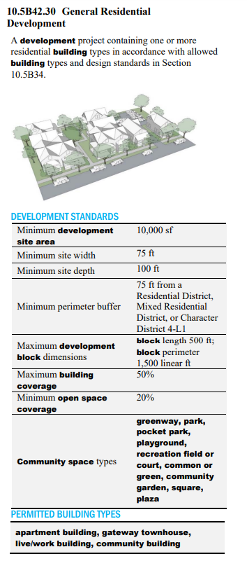
Development Sites
Notes:
Dev site standards override individual bldg. type standards for coverage, lot area, and lot dimensions, but otherwise bldg. type standards still apply for the different bldgs. within the site. Standards include a list of the building types permitted in each dev site type.

Slide 13
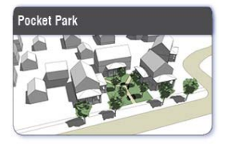
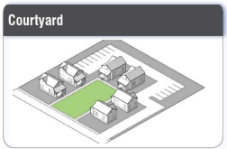
COMMUNITY SPACE TYPES
COMMUNITY SPACE TYPES | DEVELOPMENT SITES
 | Mixed Use Development | Pocket Neighborhood | General Residential Development | General Commercial Development
Park | P | P | P | P
Greenway | P | P | P | P
Pedestrian Alley | P |  | P | P
Wide Pedestrian Sidewalk | P |  | P | P
Pocket Park | P | P | P | P
Playground | P | P | P
Recreation Field* | P | P | P
Common or Green* | P | P | P | P
Community Garden* | P | P | P
Outdoor Dining Café* | P |  |  | P
Square | P |  | P | P
Plaza | P |  | P | P
Courtyard* | P | P | P | P
Notes:
All dev. Sites are required to provide some community spaces. Community Spaces (as applicable to Article 5B) are privately owned and oriented and accessible to the public. Consistent with what we have done in the Character Districts (5A), we identify a list of types that are allowed. The list of community open space types themselves are included in Article 5A. The ones indicated with an * are ones that were added during the Gateway amendments.

Slide 14
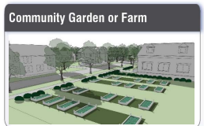
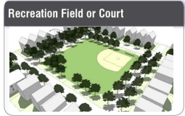
COMMUNITY SPACE IN GATEWAY DISTRICTS
For Development Sites:
In the G1 District, the minimum community space coverage shall be equal to 10% of the total site area of the development site.
In the G2 District, the minimum community space coverage shall be equal to 20% of the total site area of the development site.
Notes:
Standard requirement and not related to any incentives.

Slide 15
DENSITY THRESHOLDS
RESIDENTIAL DENSITY (Dwelling Units per Acre)
Building Type | Gateway Mixed Use Corridor (G1) |  | Gateway Mixed Use Center (G2)
 | P | CU | P | CU
Cottage | NR | NR | NR | NR
Paired House | NR | NR | NR | NR
Apartment Building | 16 | 24 | 16 | 24
Gateway Townhouse | 16 | 24 | 16 | 24
Live-Work Building | 16 | 24 | 16 | 24
Mixed-Use Building | 16 | 24 | 16 | 24
Notes:
This section outlines the allowed density in residential units per acre for building types. Where CUP is listed, a conditional use permit may be granted by the PB to increase the allowed density.

Slide 16
GATEWAY DENSITY THRESHOLDS
RESIDENTIAL DENSITY (Dwelling Units per Acre)
Development Types | G1 |  | G2
 | P | CU | P | CU
Pocket Neighborhood | 16 | 20 | 12 | 16
Mixed Use Development | 20 | 36 | 20 | 36
General Residential Development | 20 | 36 | 20 | 36
Notes:
Density for Development sites

Slide 17
DENSITY BONUSES
DENSITY BONUS INCENTIVES BY CONDITIONAL USE PERMIT
Incentives*
Dwelling units per building
Max. of 36 units
Dwelling units per acre
Max. as shown on preceding table
Height and Building Footprint
1-story or 10’ in height
20% square footage
Requirements**
Workforce Housing
20% DUs in development (no less than 3)
Public Realm Improvements
Off-road trail or path
Public park or athletic facility
*densities can be modified above maximum by Planning Board through the CUP process
**If only 1 incentive is used, workforce housing must be provided. More than 1 incentive requires both workforce housing and public realm improvements.
Notes:
If applicant wants to increase density, provisions are included for a CUP via the PB to increase density for # of du/bldg. (24 to 36), DU per acre (as listed on previous table), and as well as height and bldg. footprint. To be granted a CUP, the applicant must meet the criteria listed in this section AND must provide public realm improvements and workforce housing. Densities can be modified further by the Planning Board provided that the Planning Board finds such modification will promote design flexibility and overall project quality, or that such modification is required for the development to provide a proposed workforce housing component, and that such modification is consistent with the purpose and intent set forth in Section 10.5B11

Slide 18
DENSITY BONUSES
DENSITY BONUS INCENTIVES BY CONDITIONAL USE PERMIT
Workforce Housing
Ownership units – Affordable to a household with income of no more than 100% of median income for Portsmouth-Rochester HMFA
Rental units – Affordable to a household with an income of no more than 60% of the median income
Notes:
Workforce hsg as defined by state law and our ordinance

Slide 19
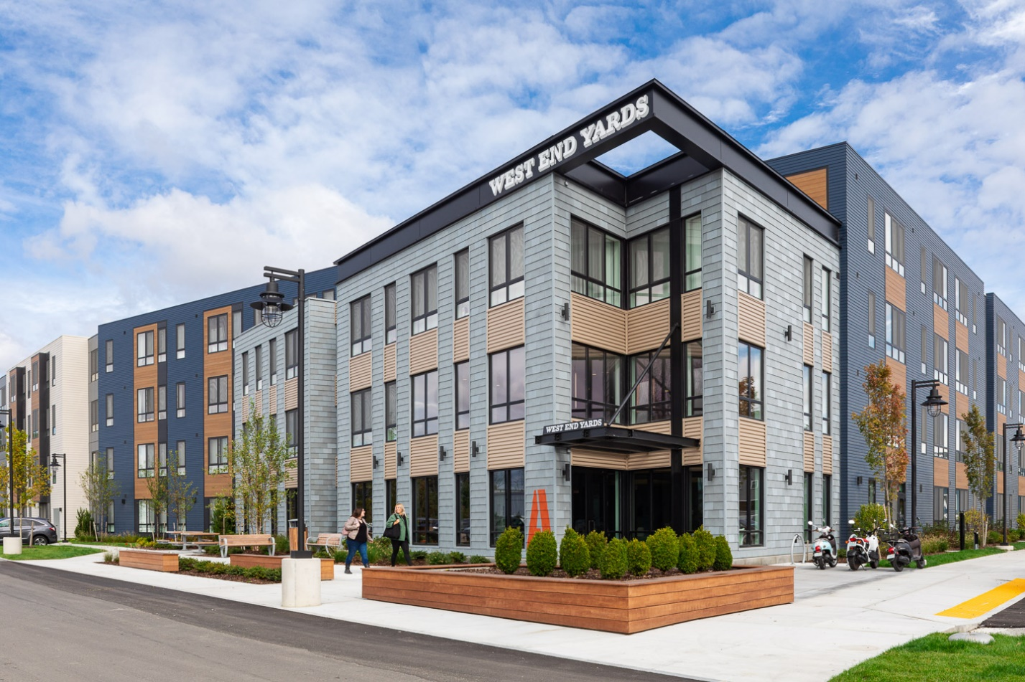
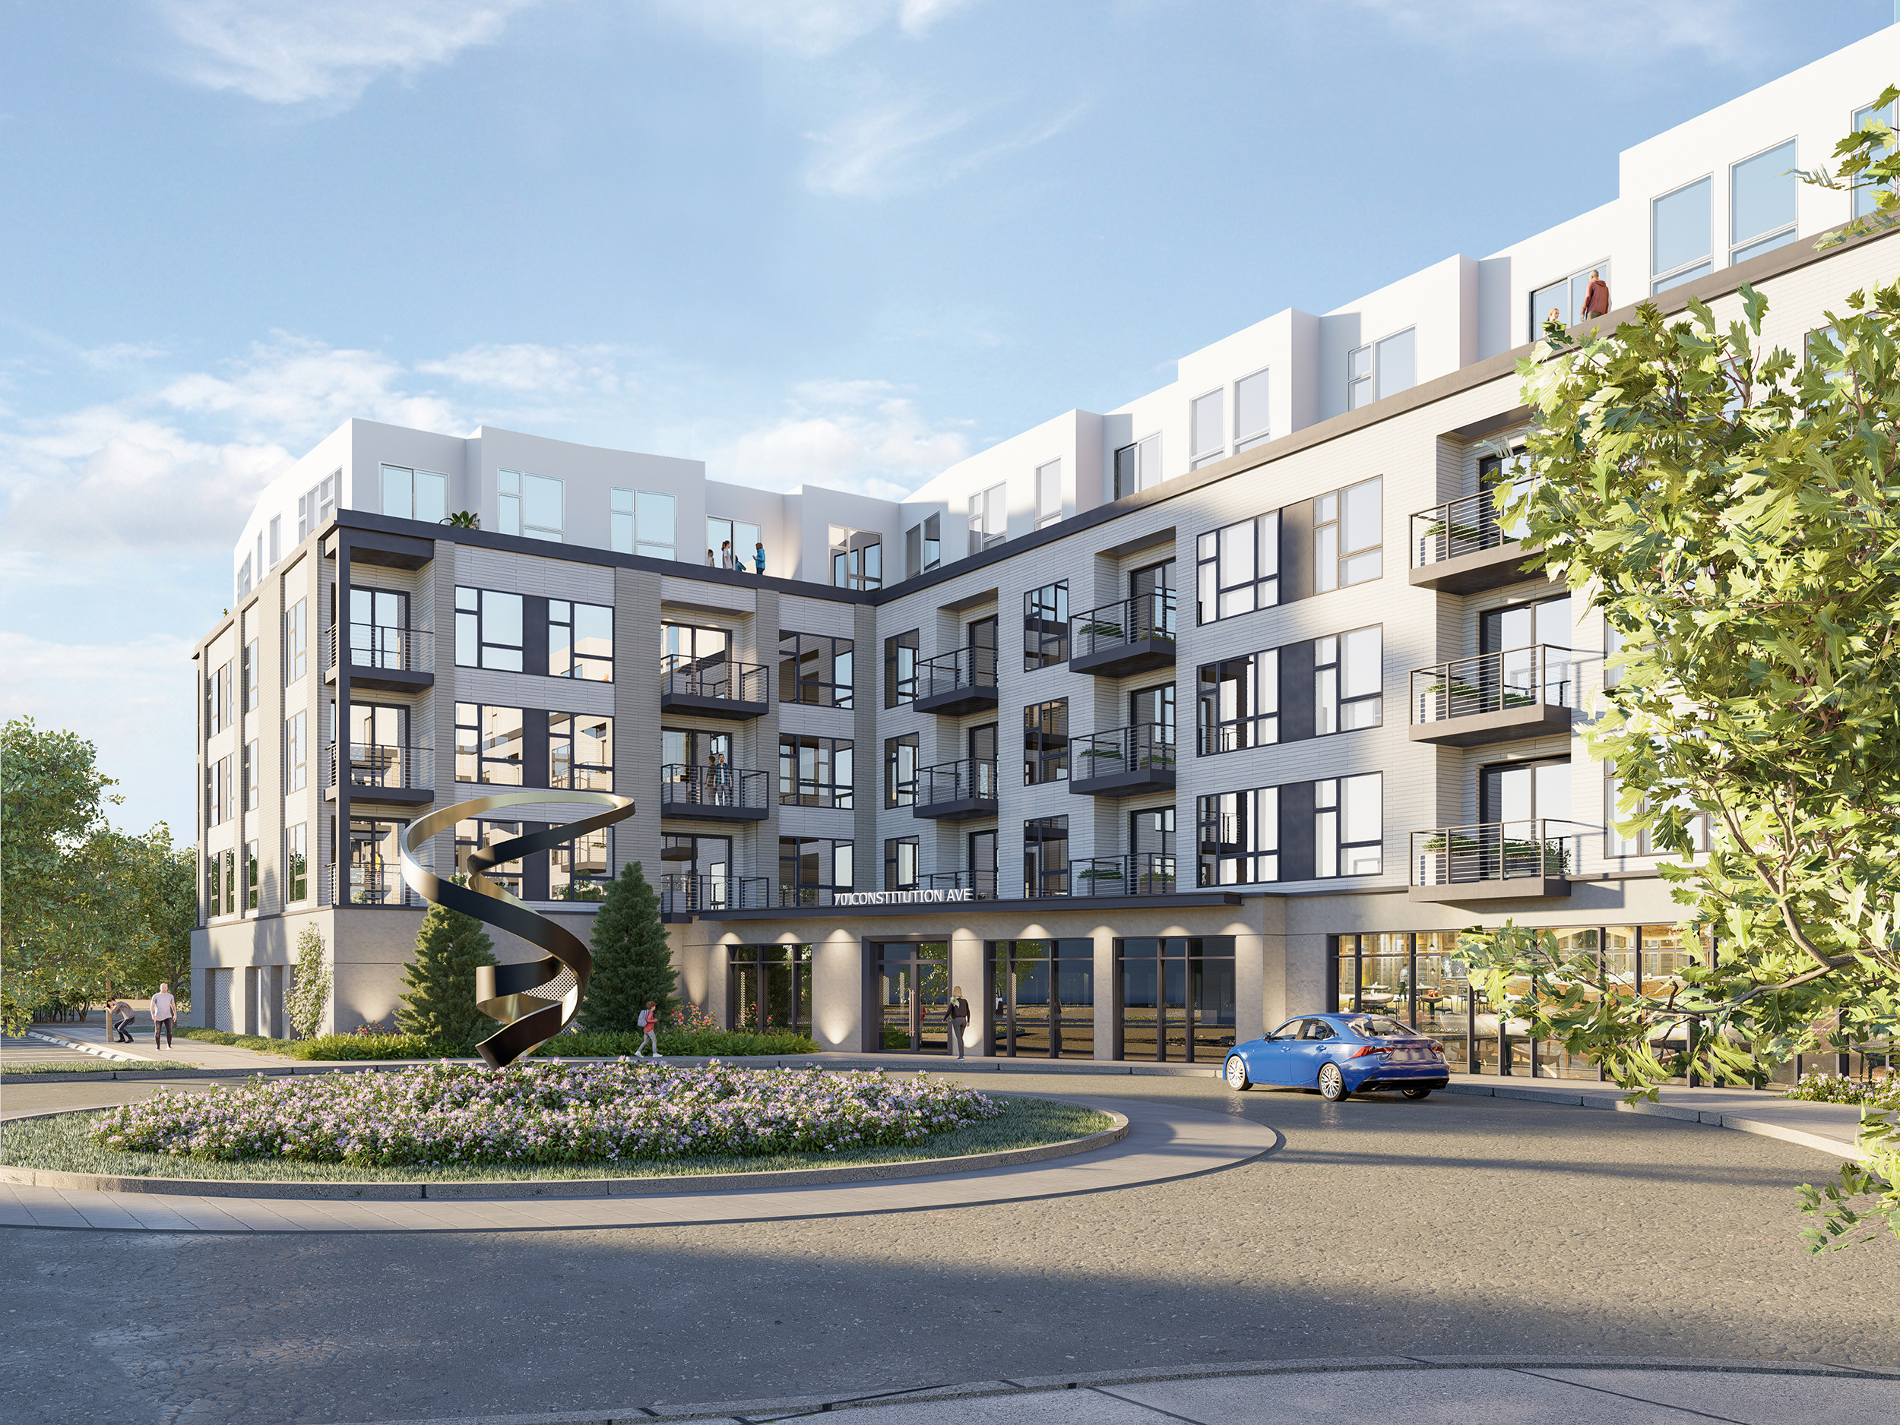
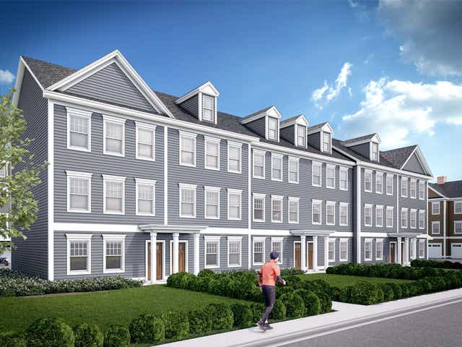
Density incentives: gateway Districts
Incentive: Density Bonus (One Story Added Height, Footprint, and Higher Density)
Public Benefit: 20% Workforce Housing (1) and 20% Community Space (2+)
Issue: The underlying density may be set too high for the incentive to be effective as 11 projects have been approved with 731 Units and only 2 projects used the incentive to add 48 Workforce Housing Units (6%).
West End Yards – Community Space and Workforce Housing
2454 Lafayette – Community Space and Workforce Housing
3400 Lafayette – Community Space

Slide 20
Density incentives: gateway Districts
Questions???

